Slide 1
ии смена
Миша дементьев 2 отряд

Slide 2
что я узнал про ИИ
вввввввввввввввввввввввввввввввввввввввввввввввввввввввввввввввввввввввввввввввввввввввввввввввввввввввввввввввввввввввввввввввввввввввввввввввввввввввввввввввввввввввввввввввввввввввввввввввввввввввввввввввввввввввввввввввввввввввввввввввввввввввввввввввввввввввввввввввввввввввввввввввввввввввввввввввввввввввввввввввввввввввввввввввввввввввввввввввввввввввввввввввввввввввввввввввввввввввввввввввввввввввввввввввввввввввввввввввввввввввввввввввввввввввввввввввввввввввввввввввввввввввввввввввввввввввввввввввввввввввввввввввввввввввввввввввввввввввввввввввввввввввввввввввввввввввввввввввввввввввввввввввввввввввввввввввввввввввввввввввввввввввввввввввввввввввввввввввввввввввввввввввввввввввввввввввввввввввввввввввввввввввввввввввввввввввввввввввввввввввввввввввввввввввввввввввввввввввввввввввввввввввввввввввввввввввввввввввввввввввввввввввввввввввввввввввввввввввввввввввввввввввввввввввввввввввввввввввввввввввввввввввввввввввввввввввввввввввввввввввввввввввввввввввввввввввввввввввввввввввввввввввввввввввввввввввввввввввввввввввввввввввввввввввввввввввввввввчто с помощью ИИ можно делать фото и видео

Slide 3
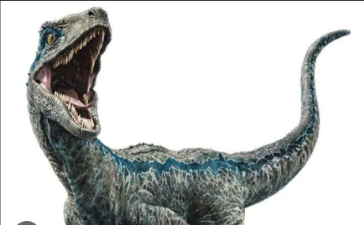
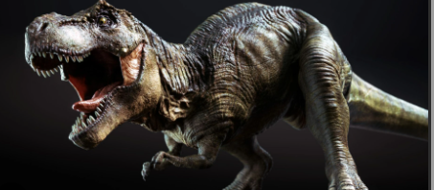
что я сделал с помощью ИИ
видио где велоцераптор напал на терекса

Slide 4
СПАСИБО ЗА ВНИМАНИЕ

