Slide 1
тема: прыжок веры
создал магер егор

Slide 2
я выбрал эту тему потому что в проекте надо прыгать за предметами их продавать ,покупать улучшение на прыжок

Slide 3
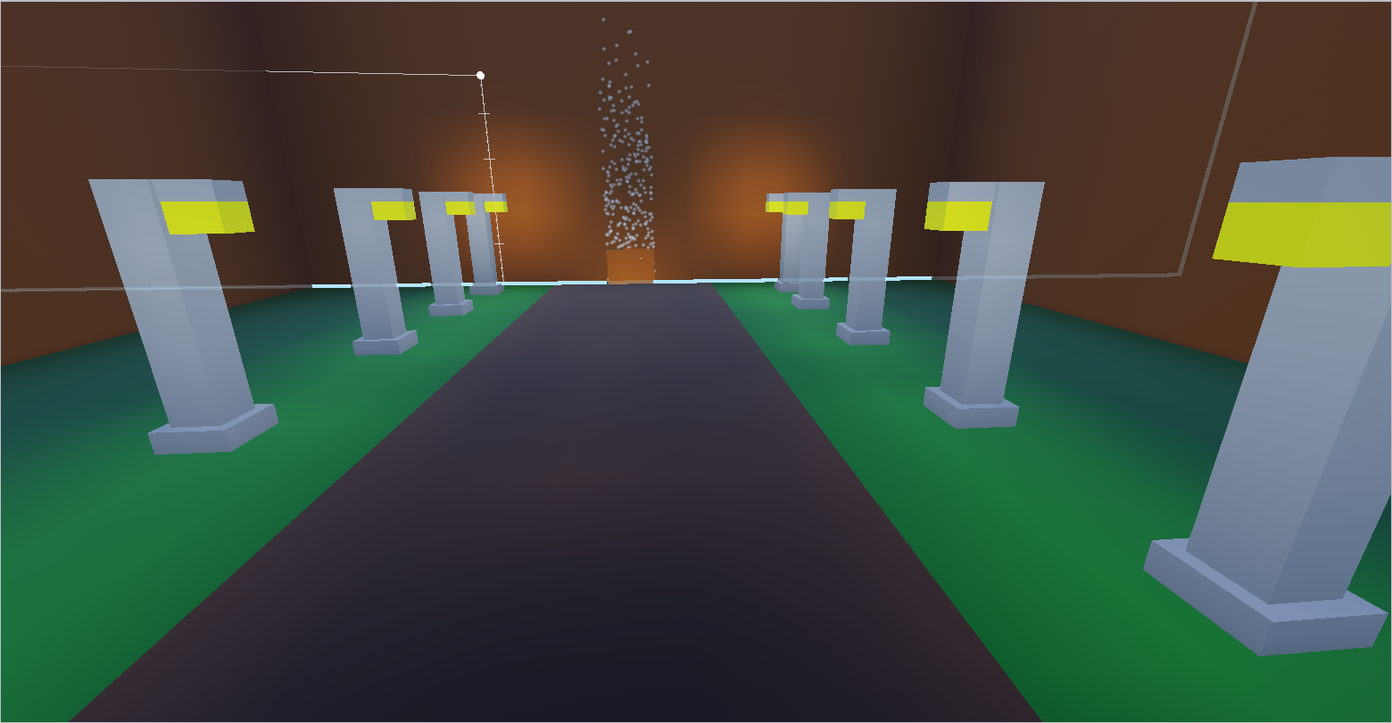
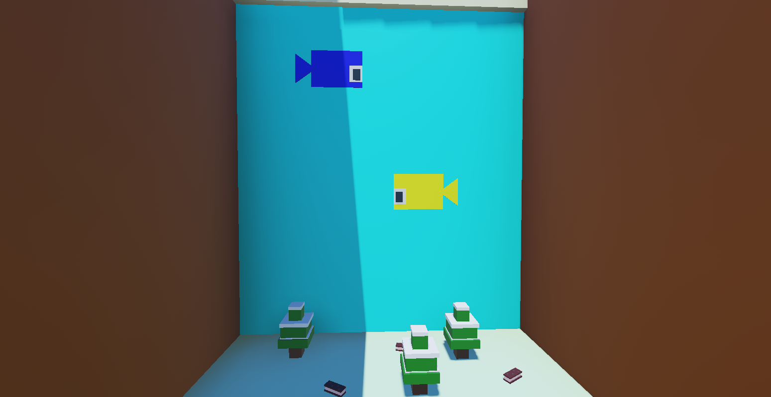
карта

Slide 4
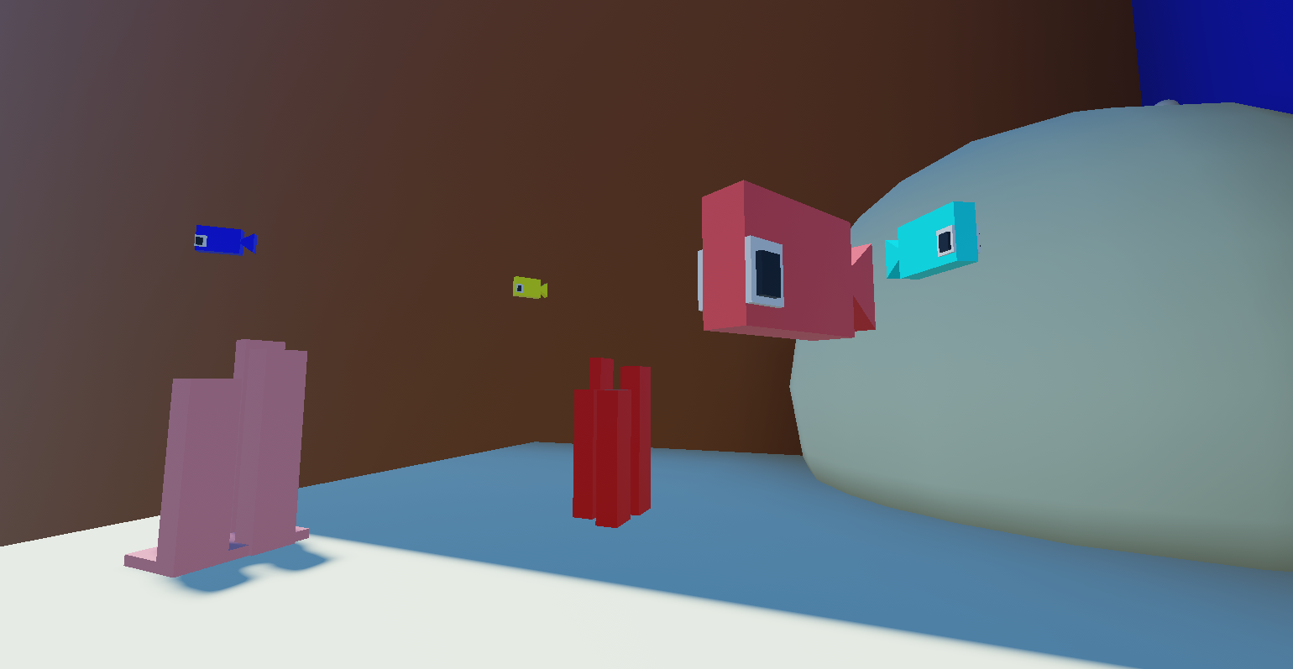
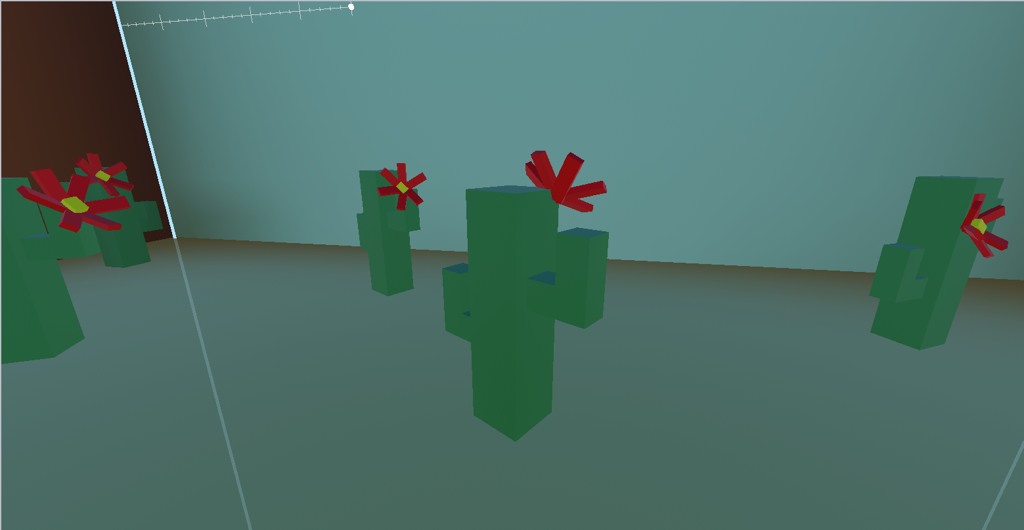
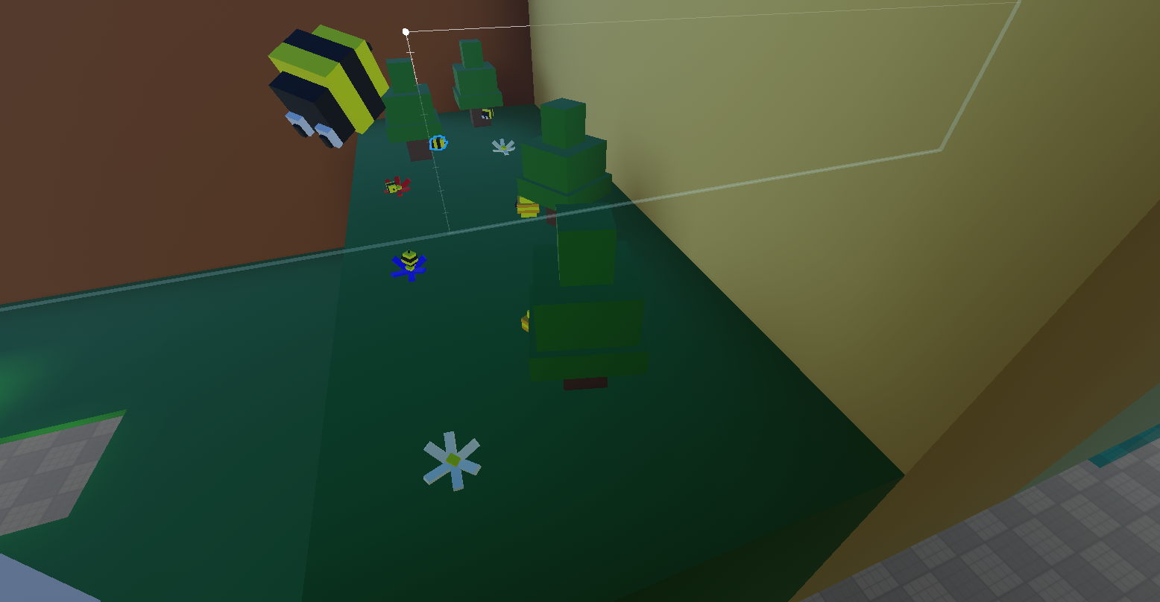
карта

Slide 5
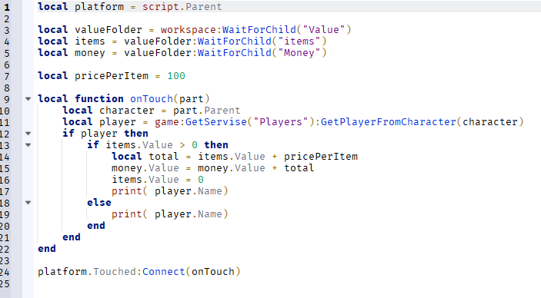
скрипты

Slide 6
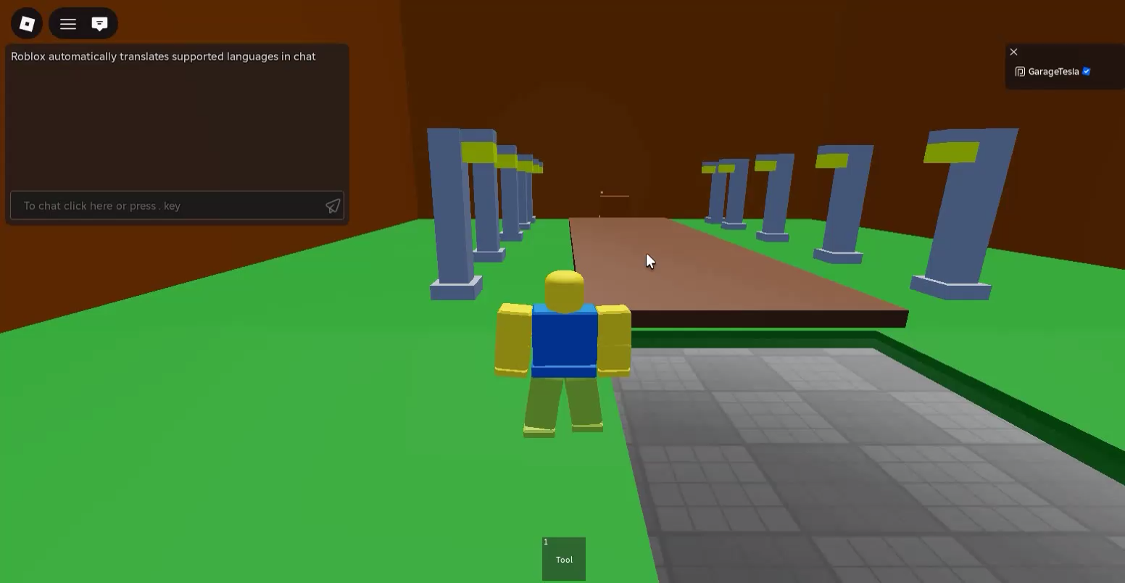
гейм плей

Slide 7
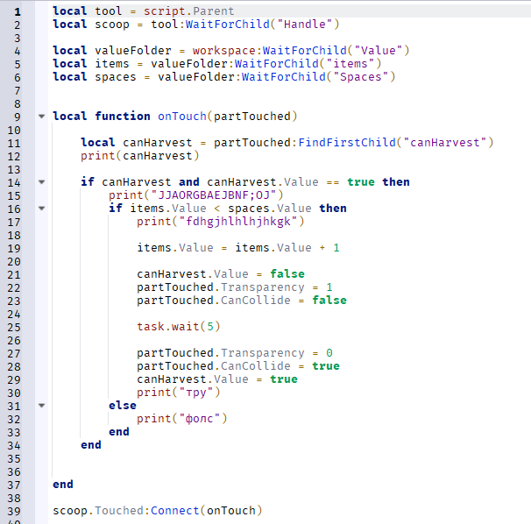
еще скрипты

Slide 8
спасибо за внимани
……………………………………………………………….……………………………………………………………….……………………………………………………………….……………………………………………………………….……………………………………………………………….……………………………………………………………….……………………………………………………………….……………………………………………………………….……………………………………………………………….……………………………………………………………….……………………………………………………………….……………………………………………………………….……………………………………………………………….……………………………………………………………….……………………………………………………………….……………………………………………………………….……………………………………………………………….……………………………………………………………….……………………………………………………………….……………………………………………………………….……………………………………………………………….……………………………………………………………….……………………………………………………………….……………………………………………………………….……………………………………………………………….……………………………………………………………….……………………………………………………………….……………………………………………………………….……………………………………………………………….……………………………………………………………….……………………………………………………………….……………………………………………………………….……………………………………………………………….……………………………………………………………….……………………………………………………………….……………………………………………………………….……………………………………………………………….……………………………………………………………….……………………………………………………………….……………………………………………………………….……………………………………………………………….……………………………………………………………….……………………………………………………………….……………………………………………………………….……………………………………………………………….……………………………………………………………….……………………………………………………………….……………………………………………………………….……………………………………………………………….……………………………………………………………….……………………………………………………………….……………………………………………………………….……………………………………………………………….……………………………………………………………….……………………………………………………………….……………………………………………………………….……………………………………………………………….……………………………………………………………….……………………………………………………………….………………………………………………………………….……………………………………………………………….……………………………………………………………….……………………………………………………………….……………………………………………………………….……………………………………………………………….……………………………………………………………….……………………………………………………………….……………………………………………………………….……………………………………………………………….……………………………………………………………….……………………………………………………………….……………………………………………………………….……………………………………………………………….……………………………………………………………….……………………………………………………………….……………………………………………………………….……………………………………………………………….……………………………………………………………….……………………………………………………………….……………………………………………………………….……………………………………………………………….……………………………………………………………….……………………………………………………………….……………………………………………………………….……………………………………………………………….……………………………………………………………….……………………………………………………………….……………………………………………………………….……………………………………………………………….……………………………………………………………….……………………………………………………………….……………………………………………………………….……………………………………………………………….……………………………………………………………….……………………………………………………………….……………………………………………………………….……………………………………………………………….……………………………………………………………….……………………………………………………………….……………………………………………………………….……………………………………………………………….……………………………………………………………….……………………………………………………………….……………………………………………………………….……………………………………………………………….……………………………………………………………….……………………………………………………………….……………………………………………………………….……………………………………………………………….……………………………………………………………….……………………………………………………………….……………………………………………………………….……………………………………………………………….……………………………………………………………….……………………………………………………………….……………………………………………………………….……………………………………………………………….……………………………………………………………….………………………………………………………………….……………………………………………………………….……………………………………………………………….……………………………………………………………….……………………………………………………………….……………………………………………………………….……………………………………………………………….……………………………………………………………….……………………………………………………………….……………………………………………………………….……………………………………………………………….……………………………………………………………….……………………………………………………………….……………………………………………………………….……………………………………………………………….……………………………………………………………….……………………………………………………………….……………………………………………………………….……………………………………………………………….……………………………………………………………….……………………………………………………………….……………………………………………………………….……………………………………………………………….……………………………………………………………….……………………………………………………………….……………………………………………………………….……………………………………………………………….……………………………………………………………….……………………………………………………………….……………………………………………………………….……………………………………………………………….……………………………………………………………….……………………………………………………………….……………………………………………………………….……………………………………………………………….……………………………………………………………….……………………………………………………………….……………………………………………………………….……………………………………………………………….……………………………………………………………….……………………………………………………………….……………………………………………………………….……………………………………………………………….……………………………………………………………….……………………………………………………………….……………………………………………………………….……………………………………………………………….……………………………………………………………….……………………………………………………………….……………………………………………………………….……………………………………………………………….……………………………………………………………….……………………………………………………………….……………………………………………………………….……………………………………………………………….……………………………………………………………….……………………………………………………………….……………………………………………………………….……………………………………………………………….………………………………………………………………….……………………………………………………………….……………………………………………………………….……………………………………………………………….……………………………………………………………….……………………………………………………………….……………………………………………………………….……………………………………………………………….……………………………………………………………….……………………………………………………………….……………………………………………………………….……………………………………………………………….……………………………………………………………….……………………………………………………………….……………………………………………………………….……………………………………………………………….……………………………………………………………….……………………………………………………………….……………………………………………………………….……………………………………………………………….……………………………………………………………….……………………………………………………………….……………………………………………………………….……………………………………………………………….……………………………………………………………….……………………………………………………………….……………………………………………………………….……………………………………………………………….……………………………………………………………….……………………………………………………………….……………………………………………………………….……………………………………………………………….……………………………………………………………….……………………………………………………………….……………………………………………………………….……………………………………………………………….……………………………………………………………….……………………………………………………………….……………………………………………………………….……………………………………………………………….……………………………………………………………….……………………………………………………………….……………………………………………………………….……………………………………………………………….……………………………………………………………….……………………………………………………………….……………………………………………………………….……………………………………………………………….……………………………………………………………….……………………………………………………………….……………………………………………………………….……………………………………………………………….……………………………………………………………….……………………………………………………………….……………………………………………………………….……………………………………………………………….……………………………………………………………….……………………………………………………………….……………………………………………………………….………………………………………………………………….……………………………………………………………….……………………………………………………………….……………………………………………………………….……………………………………………………………….……………………………………………………………….……………………………………………………………….……………………………………………………………….……………………………………………………………….……………………………………………………………….……………………………………………………………….……………………………………………………………….……………………………………………………………….……………………………………………………………….……………………………………………………………….……………………………………………………………….……………………………………………………………….……………………………………………………………….……………………………………………………………….……………………………………………………………….……………………………………………………………….……………………………………………………………….……………………………………………………………….……………………………………………………………….……………………………………………………………….……………………………………………………………….……………………………………………………………….……………………………………………………………….……………………………………………………………….……………………………………………………………….……………………………………………………………….……………………………………………………………….……………………………………………………………….……………………………………………………………….……………………………………………………………….……………………………………………………………….……………………………………………………………….……………………………………………………………….……………………………………………………………….……………………………………………………………….……………………………………………………………….……………………………………………………………….……………………………………………………………….……………………………………………………………….……………………………………………………………….……………………………………………………………….……………………………………………………………….……………………………………………………………….……………………………………………………………….……………………………………………………………….……………………………………………………………….……………………………………………………………….……………………………………………………………….……………………………………………………………….……………………………………………………………….……………………………………………………………….……………………………………………………………….……………………………………………………………….……………………………………………………………….………………………………………………………………….……………………………………………………………….……………………………………………………………….……………………………………………………………….……………………………………………………………….……………………………………………………………….……………………………………………………………….……………………………………………………………….……………………………………………………………….……………………………………………………………….……………………………………………………………….……………………………………………………………….……………………………………………………………….……………………………………………………………….……………………………………………………………….……………………………………………………………….……………………………………………………………….……………………………………………………………….……………………………………………………………….……………………………………………………………….……………………………………………………………….……………………………………………………………….……………………………………………………………….……………………………………………………………….……………………………………………………………….……………………………………………………………….……………………………………………………………….……………………………………………………………….……………………………………………………………….……………………………………………………………….……………………………………………………………….……………………………………………………………….……………………………………………………………….……………………………………………………………….……………………………………………………………….……………………………………………………………….……………………………………………………………….……………………………………………………………….……………………………………………………………….……………………………………………………………….……………………………………………………………….……………………………………………………………….……………………………………………………………….……………………………………………………………….……………………………………………………………….……………………………………………………………….……………………………………………………………….……………………………………………………………….……………………………………………………………….……………………………………………………………….……………………………………………………………….……………………………………………………………….……………………………………………………………….……………………………………………………………….……………………………………………………………….……………………………………………………………….……………………………………………………………….……………………………………………………………….……………………………………………………………….………………………………………………………………….……………………………………………………………….……………………………………………………………….……………………………………………………………….……………………………………………………………….……………………………………………………………….……………………………………………………………….……………………………………………………………….……………………………………………………………….……………………………………………………………….……………………………………………………………….……………………………………………………………….……………………………………………………………….……………………………………………………………….……………………………………………………………….……………………………………………………………….……………………………………………………………….……………………………………………………………….……………………………………………………………….……………………………………………………………….……………………………………………………………….……………………………………………………………….……………………………………………………………….……………………………………………………………….……………………………………………………………….……………………………………………………………….……………………………………………………………….……………………………………………………………….……………………………………………………………….……………………………………………………………….……………………………………………………………….……………………………………………………………….……………………………………………………………….……………………………………………………………….……………………………………………………………….……………………………………………………………….……………………………………………………………….……………………………………………………………….……………………………………………………………….……………………………………………………………….……………………………………………………………….……………………………………………………………….……………………………………………………………….……………………………………………………………….……………………………………………………………….……………………………………………………………….……………………………………………………………….……………………………………………………………….……………………………………………………………….……………………………………………………………….……………………………………………………………….……………………………………………………………….……………………………………………………………….……………………………………………………………….……………………………………………………………….……………………………………………………………….……………………………………………………………….……………………………………………………………….……………………………………………………………….………………………………………………………………….……………………………………………………………….……………………………………………………………….……………………………………………………………….……………………………………………………………….……………………………………………………………….……………………………………………………………….……………………………………………………………….……………………………………………………………….……………………………………………………………….……………………………………………………………….……………………………………………………………….……………………………………………………………….……………………………………………………………….……………………………………………………………….……………………………………………………………….……………………………………………………………….……………………………………………………………….……………………………………………………………….……………………………………………………………….……………………………………………………………….……………………………………………………………….……………………………………………………………….……………………………………………………………….……………………………………………………………….……………………………………………………………….……………………………………………………………….……………………………………………………………….……………………………………………………………….……………………………………………………………….……………………………………………………………….……………………………………………………………….……………………………………………………………….……………………………………………………………….……………………………………………………………….……………………………………………………………….……………………………………………………………….……………………………………………………………….……………………………………………………………….……………………………………………………………….……………………………………………………………….……………………………………………………………….……………………………………………………………….……………………………………………………………….……………………………………………………………….……………………………………………………………….……………………………………………………………….……………………………………………………………….……………………………………………………………….……………………………………………………………….……………………………………………………………….……………………………………………………………….……………………………………………………………….……………………………………………………………….……………………………………………………………….……………………………………………………………….……………………………………………………………….……………………………………………………………….……………………………………………………………….………………………………………………………………….……………………………………………………………….……………………………………………………………….……………………………………………………………….……………………………………………………………….……………………………………………………………….……………………………………………………………….……………………………………………………………….……………………………………………………………….……………………………………………………………….……………………………………………………………….……………………………………………………………….……………………………………………………………….……………………………………………………………….……………………………………………………………….……………………………………………………………….……………………………………………………………….……………………………………………………………….……………………………………………………………….……………………………………………………………….……………………………………………………………….……………………………………………………………….……………………………………………………………….……………………………………………………………….……………………………………………………………….……………………………………………………………….……………………………………………………………….……………………………………………………………….……………………………………………………………….……………………………………………………………….……………………………………………………………….……………………………………………………………….……………………………………………………………….……………………………………………………………….……………………………………………………………….……………………………………………………………….……………………………………………………………….……………………………………………………………….……………………………………………………………….……………………………………………………………….……………………………………………………………….……………………………………………………………….……………………………………………………………….……………………………………………………………….……………………………………………………………….……………………………………………………………….……………………………………………………………….……………………………………………………………….……………………………………………………………….……………………………………………………………….……………………………………………………………….……………………………………………………………….……………………………………………………………….……………………………………………………………….……………………………………………………………….……………………………………………………………….……………………………………………………………….……………………………………………………………….……………………………………………………………….………………………………………………………………….……………………………………………………………….……………………………………………………………….……………………………………………………………….……………………………………………………………….……………………………………………………………….……………………………………………………………….……………………………………………………………….……………………………………………………………….……………………………………………………………….……………………………………………………………….……………………………………………………………….……………………………………………………………….……………………………………………………………….……………………………………………………………….……………………………………………………………….……………………………………………………………….……………………………………………………………….……………………………………………………………….……………………………………………………………….……………………………………………………………….……………………………………………………………….……………………………………………………………….……………………………………………………………….……………………………………………………………….……………………………………………………………….……………………………………………………………….……………………………………………………………….……………………………………………………………….……………………………………………………………….……………………………………………………………….……………………………………………………………….……………………………………………………………….……………………………………………………………….……………………………………………………………….……………………………………………………………….……………………………………………………………….……………………………………………………………….……………………………………………………………….……………………………………………………………….……………………………………………………………….……………………………………………………………….……………………………………………………………….……………………………………………………………….……………………………………………………………….……………………………………………………………….……………………………………………………………….……………………………………………………………….……………………………………………………………….……………………………………………………………….……………………………………………………………….……………………………………………………………….……………………………………………………………….……………………………………………………………….……………………………………………………………….……………………………………………………………….……………………………………………………………….……………………………………………………………….……………………………………………………………….………………………………………………………………….……………………………………………………………….……………………………………………………………….……………………………………………………………….……………………………………………………………….……………………………………………………………….……………………………………………………………….……………………………………………………………….……………………………………………………………….……………………………………………………………….……………………………………………………………….……………………………………………………………….……………………………………………………………….……………………………………………………………….……………………………………………………………….……………………………………………………………….……………………………………………………………….……………………………………………………………….……………………………………………………………….……………………………………………………………….……………………………………………………………….……………………………………………………………….……………………………………………………………….……………………………………………………………….……………………………………………………………….……………………………………………………………….……………………………………………………………….……………………………………………………………….……………………………………………………………….……………………………………………………………….……………………………………………………………….……………………………………………………………….……………………………………………………………….……………………………………………………………….……………………………………………………………….……………………………………………………………….……………………………………………………………….……………………………………………………………….……………………………………………………………….……………………………………………………………….……………………………………………………………….……………………………………………………………….……………………………………………………………….……………………………………………………………….……………………………………………………………….……………………………………………………………….……………………………………………………………….……………………………………………………………….……………………………………………………………….……………………………………………………………….……………………………………………………………….……………………………………………………………….……………………………………………………………….……………………………………………………………….……………………………………………………………….……………………………………………………………….……………………………………………………………….……………………………………………………………….……………………………………………………………….………………………………………………………………….……………………………………………………………….……………………………………………………………….……………………………………………………………….……………………………………………………………….……………………………………………………………….……………………………………………………………….……………………………………………………………….……………………………………………………………….……………………………………………………………….……………………………………………………………….……………………………………………………………….……………………………………………………………….……………………………………………………………….……………………………………………………………….……………………………………………………………….……………………………………………………………….……………………………………………………………….……………………………………………………………….……………………………………………………………….……………………………………………………………….……………………………………………………………….……………………………………………………………….……………………………………………………………….……………………………………………………………….……………………………………………………………….……………………………………………………………….……………………………………………………………….……………………………………………………………….……………………………………………………………….……………………………………………………………….……………………………………………………………….……………………………………………………………….……………………………………………………………….……………………………………………………………….……………………………………………………………….……………………………………………………………….……………………………………………………………….……………………………………………………………….……………………………………………………………….……………………………………………………………….……………………………………………………………….……………………………………………………………….……………………………………………………………….……………………………………………………………….……………………………………………………………….……………………………………………………………….……………………………………………………………….……………………………………………………………….……………………………………………………………….……………………………………………………………….……………………………………………………………….……………………………………………………………….……………………………………………………………….……………………………………………………………….……………………………………………………………….……………………………………………………………….……………………………………………………………….……………………………………………………………….………………………………………………………………….……………………………………………………………….……………………………………………………………….……………………………………………………………….……………………………………………………………….……………………………………………………………….……………………………………………………………….……………………………………………………………….……………………………………………………………….……………………………………………………………….……………………………………………………………….……………………………………………………………….……………………………………………………………….……………………………………………………………….……………………………………………………………….……………………………………………………………….……………………………………………………………….……………………………………………………………….……………………………………………………………….……………………………………………………………….……………………………………………………………….……………………………………………………………….……………………………………………………………….……………………………………………………………….……………………………………………………………….……………………………………………………………….……………………………………………………………….……………………………………………………………….……………………………………………………………….……………………………………………………………….……………………………………………………………….……………………………………………………………….……………………………………………………………….……………………………………………………………….……………………………………………………………….……………………………………………………………….……………………………………………………………….……………………………………………………………….……………………………………………………………….……………………………………………………………….……………………………………………………………….……………………………………………………………….……………………………………………………………….……………………………………………………………….……………………………………………………………….……………………………………………………………….……………………………………………………………….……………………………………………………………….……………………………………………………………….……………………………………………………………….……………………………………………………………….……………………………………………………………….……………………………………………………………….……………………………………………………………….……………………………………………………………….……………………………………………………………….……………………………………………………………….……………………………………………………………….……………………………………………………………….………………………………………………………………….……………………………………………………………….……………………………………………………………….……………………………………………………………….……………………………………………………………….……………………………………………………………….……………………………………………………………….……………………………………………………………….……………………………………………………………….……………………………………………………………….……………………………………………………………….……………………………………………………………….……………………………………………………………….……………………………………………………………….……………………………………………………………….……………………………………………………………….……………………………………………………………….……………………………………………………………….……………………………………………………………….……………………………………………………………….……………………………………………………………….……………………………………………………………….……………………………………………………………….……………………………………………………………….……………………………………………………………….……………………………………………………………….……………………………………………………………….……………………………………………………………….……………………………………………………………….……………………………………………………………….……………………………………………………………….……………………………………………………………….……………………………………………………………….……………………………………………………………….……………………………………………………………….……………………………………………………………….……………………………………………………………….……………………………………………………………….……………………………………………………………….……………………………………………………………….……………………………………………………………….……………………………………………………………….……………………………………………………………….……………………………………………………………….……………………………………………………………….……………………………………………………………….……………………………………………………………….……………………………………………………………….……………………………………………………………….……………………………………………………………….……………………………………………………………….……………………………………………………………….……………………………………………………………….……………………………………………………………….……………………………………………………………….……………………………………………………………….……………………………………………………………….……………………………………………………………….……………………………………………………………….………………………………………………………………….……………………………………………………………….……………………………………………………………….……………………………………………………………….……………………………………………………………….……………………………………………………………….……………………………………………………………….……………………………………………………………….……………………………………………………………….……………………………………………………………….……………………………………………………………….……………………………………………………………….……………………………………………………………….……………………………………………………………….……………………………………………………………….……………………………………………………………….……………………………………………………………….……………………………………………………………….……………………………………………………………….……………………………………………………………….……………………………………………………………….……………………………………………………………….……………………………………………………………….……………………………………………………………….……………………………………………………………….……………………………………………………………….……………………………………………………………….……………………………………………………………….……………………………………………………………….……………………………………………………………….……………………………………………………………….……………………………………………………………….……………………………………………………………….……………………………………………………………….……………………………………………………………….……………………………………………………………….……………………………………………………………….……………………………………………………………….……………………………………………………………….……………………………………………………………….……………………………………………………………….……………………………………………………………….……………………………………………………………….……………………………………………………………….……………………………………………………………….……………………………………………………………….……………………………………………………………….……………………………………………………………….……………………………………………………………….……………………………………………………………….……………………………………………………………….……………………………………………………………….……………………………………………………………….……………………………………………………………….……………………………………………………………….……………………………………………………………….……………………………………………………………….……………………………………………………………….……………………………………………………………….……………………………………………………………….……………………………………………………………….……………………………………………………………….……………………………………………………………….……………………………………………………………….……………………………………………………………….……………………………………………………………….

